Slide 1

Power of Pivot
(not to be confused with PowerPivot)
Notes:
PIVOT functions are awesome. Dynamic PIVOTs are awesome-er.
Turn data into information by aggregating data and rotating rows into columns.
There are three ways to pivot: Manual, PIVOT clause, and dynamic PIVOT.
Each of these will be covered, with the most time spent on dynamic pivots.

Slide 2

Peg LeDell
Query Performance Tuning Ninja, SQL Saturday Groupie, and Firefly Fan
Contact information:
Peg@SerenityCreations.net
Twitter: @SerenitySQL
LinkedIn: https://www.linkedin.com/in/ledell/

Slide 3
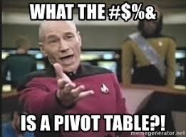
Notes:
I have been working with databases since 1997. Started out with Access before moving on to SQL Server in late 1999.
My primary tasks have been to create and optimize queries. However, I do have some experience with DTM/SSIS, Jobs, and SSRS

Slide 4
Super Technical Definition
(caution: may cause drowsiness or migraine)
A pivot table is a statistics tool that summarizes and reorganizes selected columns and rows of data in a spreadsheet or database table to obtain a desired report.
The tool does not actually change the spreadsheet or database itself, it simply “pivots” or turns the data to view it from different perspectives.

Slide 5
Super Simplified Definition
Pivots allow you to aggregate data while rotating rows into columns.
There are three elements to a pivot:
Grouping on rows
Aggregate function
Spreading on columns

Slide 6
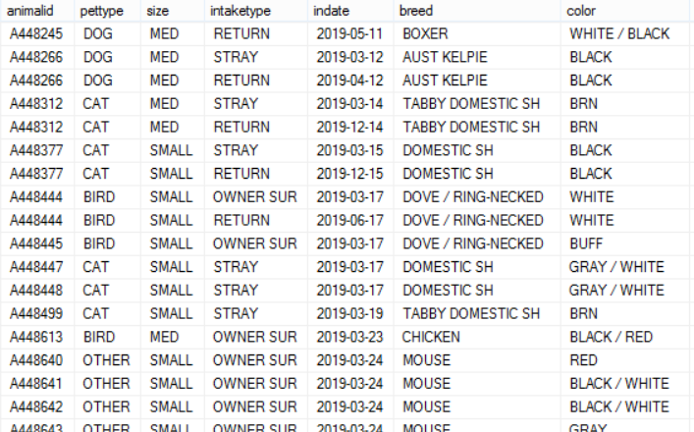
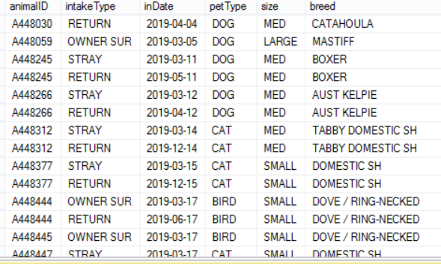
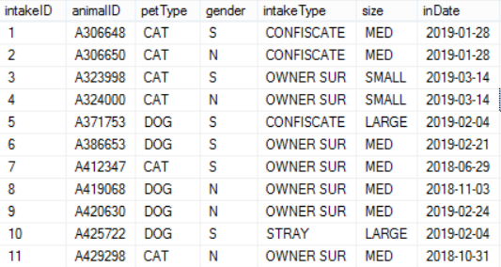
Sample Data
*Not shown is the unique intakeID field as well as other table fields

Slide 7
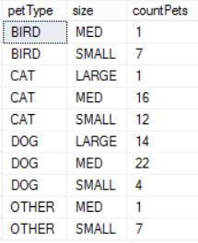
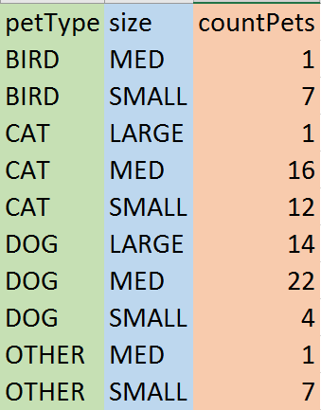
Subtotaled Data

Slide 8
Subtotaled Data

Slide 9
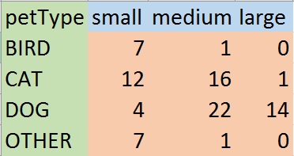
Simple Pivot Table

Slide 10
So, that’s a pivot!
Remember the three elements to a pivot
Grouping on rows
The aggregated values for each row
Aggregate function
MIN, MAX, SUM, COUNT, AVG
Spreading on columns
The definition of the aggregated values

Slide 11
Grouping on Rows

Slide 12
Aggregate Function
Aggregate function
MIN, MAX, SUM, COUNT, AVG

Slide 13
Spreading on Columns

Slide 14
Technical Pivot Syntax
(same caution: may cause drowsiness or migraine)
SELECT * FROM
(
SELECT <data for pivot plus any other relevant data>
FROM <schema.source_table>
WHERE <optional for any relevant conditions>
) src
PIVOT
(
<aggregatefunction>(<grouping_row>)
FOR <column_spread> IN([list_column_definition])
) pvt
*Not all PIVOT queries will use an asterisks in the main query, but for simplicity sake, it is ok to do.

Slide 15
SQL Server
SELECT * FROM
(
SELECT DISTINCT
ai.petType /*grouping*/
,ai.AnimalId /*aggregate*/
,ai.size /*spreading*/
FROM
dbo.AnimalIntake ai
) src
PIVOT
(
COUNT(AnimalId)
FOR size IN(small, medium, large) /*values will need bracket [ ] if values contain a space or special character*/
) pvt
;

Slide 16
Oracle
/*
The only difference in synatx is in the “FOR <field> IN(values)” section of the PIVOT operator
*/
SELECT * FROM
(
SELECT DISTINCT
ai.petType /*grouping*/
,ai.AnimalId /*aggregate*/
,ai.size /*spreading*/
FROM
dbo.AnimalIntake ai
) src
PIVOT
(
COUNT(AnimalId)
FOR size IN(‘SMALL‘ AS small, ‘MED’ AS med, ‘LARGE’ AS large)
) pvt
;

Slide 17


Slide 18


Slide 19
But Wait. There’s More!
Sometimes the customer wants multiple data points aggregated.
Enter … the Multi Pivot

Slide 20


Slide 21
But Wait. There’s More!
Manual and PIVOT operators rely on knowing what values to aggregate and pivot.
This is not always the case.
Enter … the Dynamic Pivot

Slide 22


Slide 23


Slide 24
Resources
Various URLs to find information on Pivot Operator
Dynamic PIVOT Resources
Aaron Bertrand
dynamic pivot https://www.mssqltips.com/sqlservertip/2783/script-to-create-dynamic-pivot-queries-in-sql-server/
Eli Leiba
stored procedure: https://www.mssqltips.com/sqlservertip/6245/sql-server-dynamic-pivot-query/
SQL Team
RedGate
MS SQL Tips
Stackoverflow
Google

Slide 25

Peg LeDell
Query Performance Tuning Ninja, SQL Saturday Groupie, and Firefly Fan
Contact information:
Peg@SerenityCreations.net
GitHub: https://github.com/serenitysql/PIVOT
Website: http://serenitycreations.net/

Slide 26
Thank You!
Pronto for organizing the MiniCon today
Board and Members of Unallocated Space for making this space available
Rob Volk for the encouragement
Peter Doyle for the inspiration
Attendees for your time and questions

